Slide 1
Distributed Self-Supervised Learning for the generation of Image Embeddings
ECE-GY-9143: HPML, Spring ’22
FINAL PROJECT REPORT
Harini Appansrinivasan (ha1642) and Vaibhav Mathur (vm2134)

Slide 2
Executive summary
Motivation:
Producing a dataset with clean labels is expensive
Abundant unlabeled data gets generated everyday
Image Segmentation on high resolution images has a few challenges: not memory friendly, increased complexity
Why not use low resolution images?
Self-supervised learning:
A method to generate the labels for unlabelled data and train unsupervised dataset in a supervised manner
Widely used in language modeling, such as in BERT to predict the next word given the past sequence
For Image tasks, can produce better feature embeddings as they attempt to truly capture the inherent information in the image, thus create a much better feature set for the downstream tasks
Goal:
Experiment with Self-supervised learning using low resolution images
Use Distributed Deep Learning model to create the Image Embeddings in a self-supervised manner
Test it on downstream tasks such as Image classification and RL

Slide 3
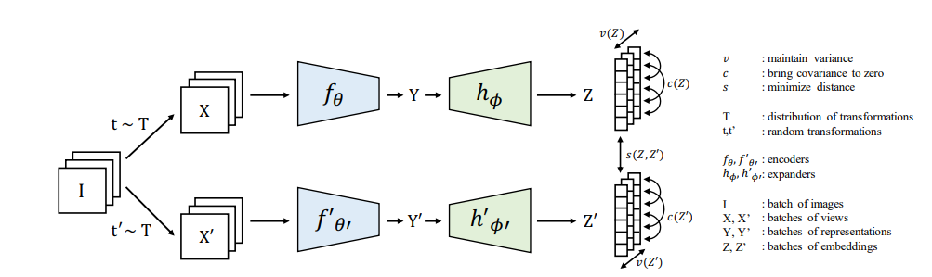
Approach
For our self-supervised learning, we have adopted the methods Vicreg and Burlow Twins.
These methods have the advantage of not requiring memory banks as is required by Contrastive methods such as SimCLR and is also theoretically more sound than methods such as BYOL.
The loss function comprises of 3 parts-
Invariance (s): Mean Square Distance between the 2 embedding vectors. This brings them closer.
Variance (v): Hinge loss to maintain the standard deviation (over a batch) of each variable of the embedding above a given threshold. This term forces the embedding vectors of samples within a batch to be different.
Covariance (c): Covariances (over a batch) between every pair of the embedding vectors. This term decorrelates the variables of each embedding and prevents an informational collapse.
Both branches share the weights in our implementation, i.e- we do 2 passes of the same network to get Y and Y’.
A Projector consisting of a single fully connected layer, a batch norm layer and a relu activation is recommended to bring about numerical stability while learning from the loss function. It is removed after training.

Slide 4
Implementation Details
Self-supervised Distributed Data Parallel model for Image Embeddings:
Datasets: CIFAR10 and tinyImageNet
Low resolution and small datasets compared to ImageNet
Image Augmentations:
GaussianBlur, Solarization, Normalization, RandomCrop, RandomHorizontalFlip, ColorJitter, Random grayscale conversion
Hardware: RTX3080, V100, RTX8000
Number of GPUs: 2, 4
Number of workers: 2, 10
Model: ResNet50 backbone
Batch sizes: 32, 128, 1024
Base learning rates: 0.3, 0.2, 0.15
Learning rate adjustment: CosineAnnealingLR
Optimizer: LARS (with weight decay) for training, SGD for evaluation
Final ResNet50 model trained at 1500 epochs

Slide 5
Main results
Self-Supervised DDL model performance comparison with different:
Hardware
Number of GPUs
Number of workers
Batch sizes
Base learning rates
Downstream Tasks Performance:
Comparison of Self-Supervised with Supervised Learning on
Image Classification
RL

Slide 6
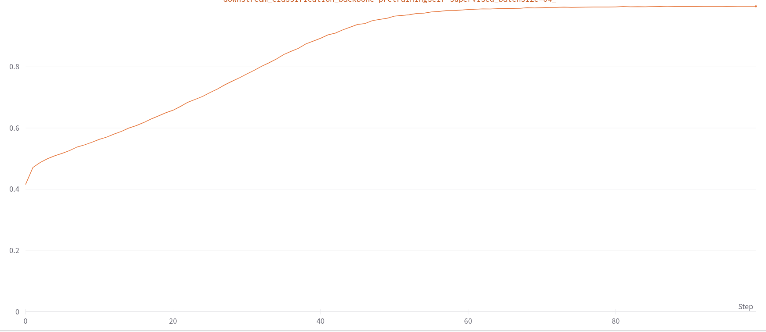
Self-Supervised DDL Model Accuracy
While training our model plateaus at 82% estimated accuracy.
After finetuning for 50 epochs, the model attains a 92.4% accuracy.

Slide 7
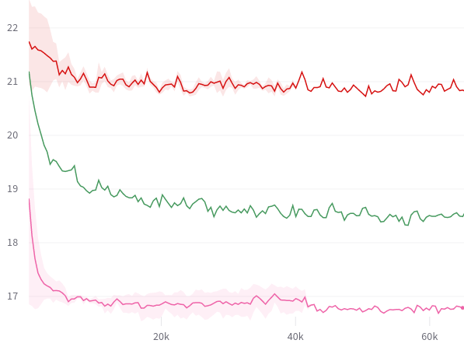
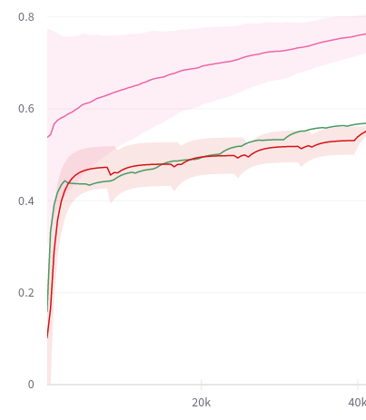
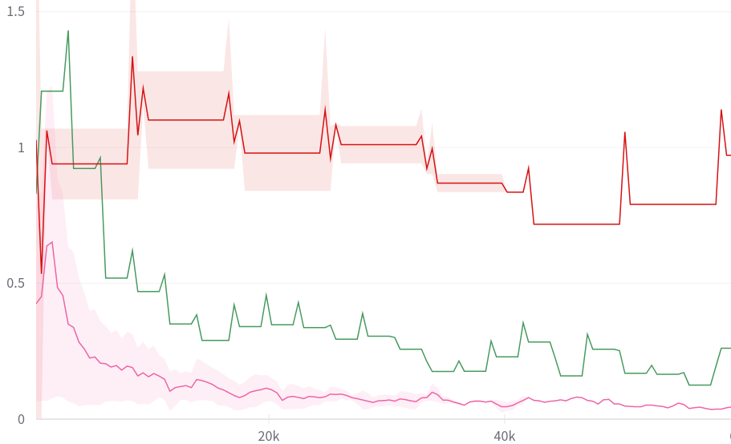
Self-Supervised DDL Model Runtime Performance
Backbone-Loss vs Time
Drops much sharply with time for the bigger batch sizes.
Suggests that increasing the batch size had a net positive effect till 1024
Training-Accuracy vs Time
Batch-Size of 1024 shows a much better growth in terms of accuracy
No Significant variation in batch sizes of 128 and 32. It suggests that higher number of per epoch updates for batch size of 32 for a fewer epochs are able to match the fewer per epoch updates but higher number of epochs for batch size of 128
Head-Loss vs Time
We run Eval loops after every 20 epochs to update the Head.
Bigger batch sizes show much better progression of Head-Loss
The primary cause behind this would be the bigger variation in the self-supervised backbone due to higher per epoch update for smaller batches, making their optimization a much more difficult task
Legend-
Red: batch-size=32, 1 GPU (RTX3080)
Green: batch-size=128, 4 GPUs (Titax X)
Pink: batch-size=1024, 2 GPUs (RTX8000)

Slide 8
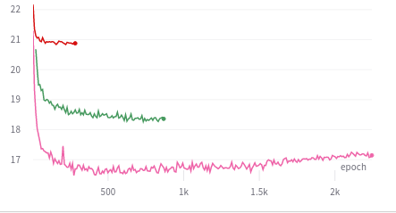
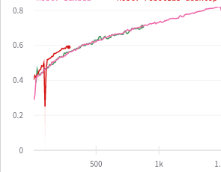
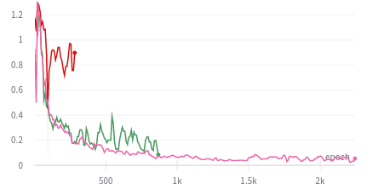
Self-Supervised DDL Model Epoch Performance
Backbone Loss vs Epoch
Even with fewer updates bigger batches perform much better.
This is primarily because of the loss function we used. Since, our loss calculates Covariance and Variance on the per batch basis, a bigger batch yields much better estimates.
It goes to show that with bigger batches the unsupervised learning approach will get much better
Accuracy vs epoch
Despite much better loss performance of the backbone, the estimated accuracy is better with batch size of 32.
This is primarily because smaller batch sizes are much better suited for the supervised classification Head.
Head Loss vs epoch
Despite slightly better accuracy, the Head Loss is much higher in batch size of 32.
This suggests that the Head for higher batch sizes are more conservative in their classification estimates.
Legend-
Red: batch-size=32, 1 GPU (RTX3080)
Green: batch-size=128, 4 GPUs (Titax X)
Pink: batch-size=1024, 2 GPUs (RTX8000)

Slide 9
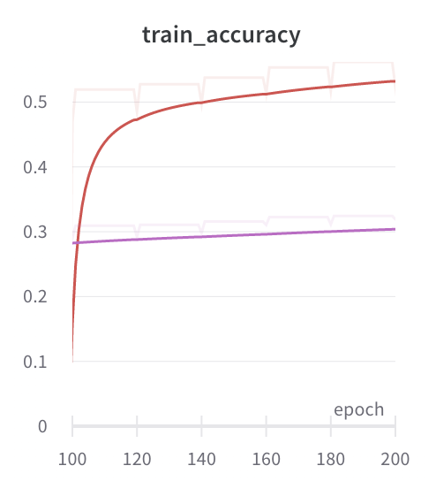
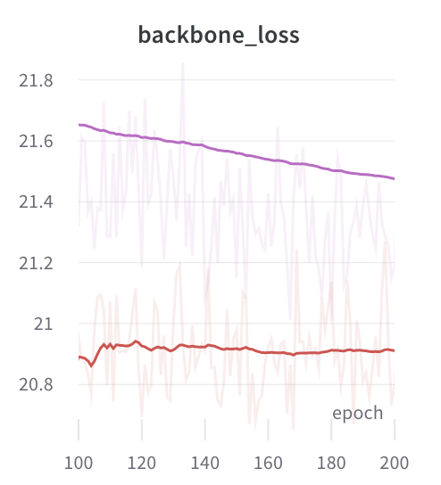
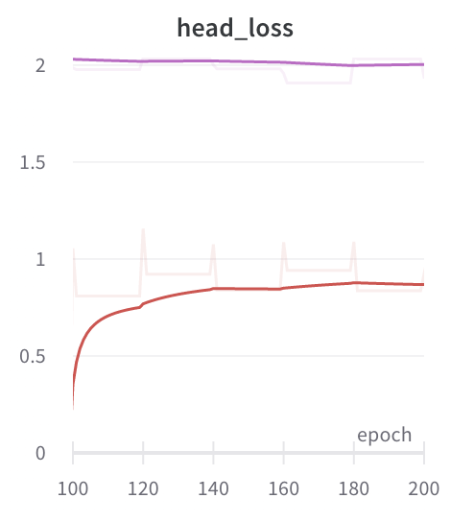
Self-Supervised DDL Model Performance- varying Base lr
As we decrease learning rate from 0.3 to 0.2:
Train Accuracy increases
Backbone and Head Loss decreases
Legend-
Pink: batch-size=32, num_workers=2, lr=0.3
Red: batch-size=32, num_workers=2, lr=0.2

Slide 10
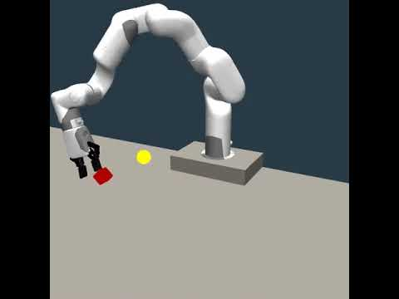
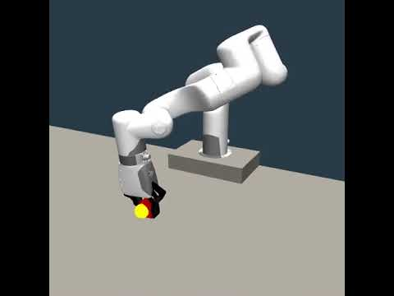
Downstream task performance- RL
Using Feature Extractor trained using Supervised Learning
Using Feature Extractor trained using Self-Supervised Learning
We see that the features captured by the Supervised method are not rich enough to allow the RL policy to extract useful info from it.
Whereas, the features captured by the Self-supervised method provide the RL policy the useful feature set, allowing it to learn the task.

Slide 11
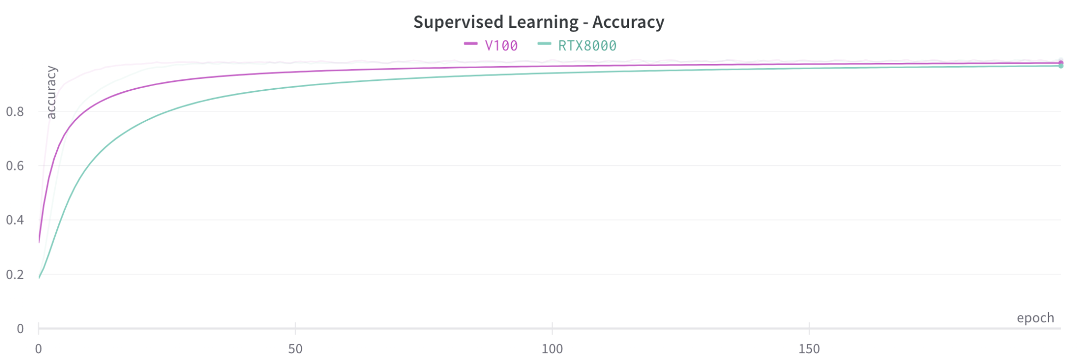
Downstream task performance- Image Classification
Supervised Model
Self-supervised Model
Accuracy attained by Supervised Learning:
(pre-trained ResNet50 using CIFAR10 dataset)
96 % in 200 epochs
Accuracy attained by Self-Supervised Learning:
96.2 % in 1500 self-supervised epochs epochs and 50 supervised epochs

Slide 12
Observations / Conclusion
Self-supervised such as Vicreg and Burlow twins can reliably train Feature extractors and prevent Mode Collapses.
Self-Supervised methods successfully learn on smaller images as well.
The features captured by the Self-supervised methods are much richer than the features captured by Supervised methods.
Self-Supervised methods are much better for a wider range of downstream tasks.
Self-Supervised methods such as ours are much better suited for scaling as intra-batch based Covariance and Variance are much more accurate.

Slide 13
Challenges / Limitations
Getting resource allocation on NYU Greene was a challenge
NYU HPC resource management has a timeout policy of 2 hours post which our session got disconnected with a low usage of GPU warning
Due to the above reasons, we were unable to experiment with different models such as VGG, ResNet101, which have a higher training time

Slide 14
Github Link:
https://github.com/vaibhav117/HPML-project
References:
Burlow Twins
MVP
SimCLR
VicReg
BYOL
MoCo
SimSiam

